Slide 1
OJT REPORT
FOR CG DEVELOPMENT
Reporter : Mao Zhengjun(毛正军)
Instructor: Liu Bing
Division : RDB-S21
2018-03-18
Notes:
大家下午好，很荣幸参加研修发表（或者其他的客套话也可以），我叫毛正军，工作于Solution2部1科
Good afternoon everyone! It is my pleasure to give a presentation（演示）here. My name is MaoZhengjun, and I am working in Department 1 Solution 2（Solution2部1科是什么？？？）

Slide 2
ＲＤＢ Organization Chart（18年1月31日付け）
董事会
董事长 ：真岡 朋光
副董事长：西原 達也
董 事 ：鈴木 正宏 監事：林 勝義
総合業務部
(王B,黄SE)
総経理：佐藤 点
副総経理：李 軍
社長直属
高級専家 西浩 司
技術管理部
(費B,翟SE,袁SE)
MCU開発一部
(王B,劉ME,林ME,李ME,
馬SE,劉SE,張SE,任SE,巴SE,楼SE)
MCU開発統括部
統括部長 野原知徳
MCU開発二部
(江B,唐ME ,周ME,孫SE ,姚SE))
BE設計部
(高SE,張SE) 鶴崎B,任ME,李SE)
Here I am
IP設計一部
(馮B,楊SE,宋SE,许SE)
IPソリューション
開発統括(李VP兼)
IP設計二部
(董ME，盧B, ,鹿SE、程SE)
S21課（15人）
（邢松寅SE(兼），劉氷K）
ソリューション開発一部
(朱B,李祥軍ME,李穎鵬ME,李洋SE)
S22課(6人）
韓秀娟K
拠点横断組織
ソリューション開発二部
(趙B,邢SE,韓SE,王SE)
北京本社地区組織
S23課(14人）
(韩景红SE，王洋SE(兼）)
蘇州分社地区組織
2
Notes:
这是我的团队
(这是你们公司总的职位分布啊，怎么是你的团队？？？)
This is my team.

Slide 3
agenda
Introduction
Schedule
Working Contents
Harvest
Goals And Plan
Notes:
As the PPT shows, my presentation is mainly divided into five parts.
Introduction, Schedule, Working Contents, Harvest, Goals and Plan.

Slide 4

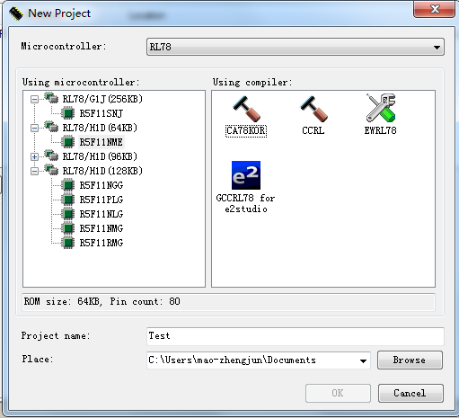
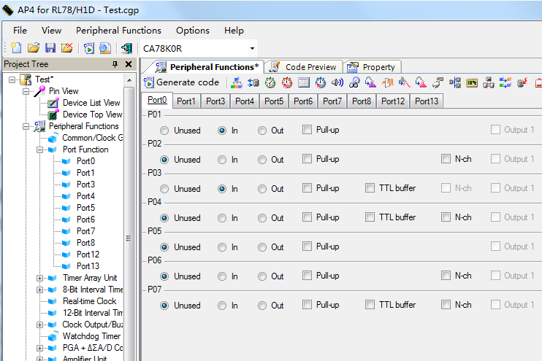
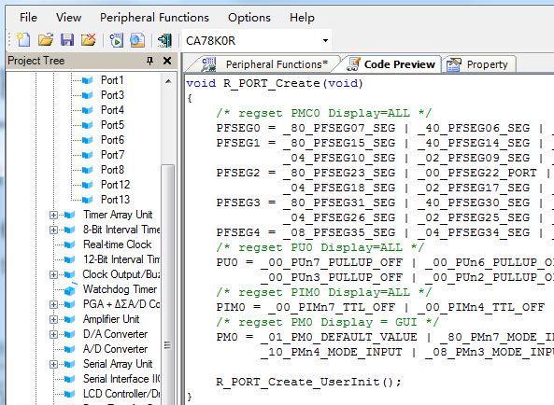
Introduction
What is the Code Generator
Code Generator is a software for generating driver code automatically by simple and convenient graphical interface configuration.
How to use it
Select device
Configure peripherals
Generate driver code
Notes:
我的工作主要是CG（Code Generator代码生成器）的开发。
这是CG的使用步骤，第一步选择芯片（设备），第二步通过界面配置外设，第三步生成驱动代码
First please allow me to introduce my work.
I spend most of my time develop Code Genaerator, which can generate the driver code.
In other words, Code Generator is a software for generating driver code automatically by simple and convenient graphical interface configuration.
How to use this software?
It’s simple and convenient.
Just follow three steps:
Step one: Select device. Choose the chip of the equipment that you want.
Step two: Configure peripherals. Configure peripherals through the interface.
Step three: Generate driver code. The software can generate the driver code automatically.

Slide 5
agenda
Introduce
Schedule
Work Report
Harvest
Plan And Goals
Notes:
Then, I am going to tell you my schedule.

Slide 6
Schedule
2017 |  |  |  |  |  | 2018
July | Aug | Sept | Oct | Nov | Dec | Jan | Feb | Mar
CG development for RL78H1D
CG development for RL78G1J
Maintenance
No. | Peripherals
1 | CGC
2 | TAU
3 | 8BITIT
4 | RTC
5 | 12BITIT
6 | TMRJ
7 | SMOTD
8 | EXSD
9 | PCLBUZ
10 | WDT
11 | PGA_DSAD
12 | AMP
13 | DA
14 | AD
15 | IICA
16 | UARTMG
… | …
No. | Peripherals
1 | CGC
2 | WDT
3 | CMP
4 | AD
5 | DA
6 | PORT
7 | TAU
8 | RTC
9 | 12BITIT
10 | TMRJ
11 | TMRD
12 | TMRG
13 | PCLBUZ
14 | SAU
15 | RF
16 | IICA
… | …
No. | Ticket
1 | #2446
2 | IDE17308
3 | #1897
4 | #2429
5 | IDE18629
6 | IDE17833
… | …
My tasks
Notes:
这是目前为止我所有的工作安排，共有两个项目，黄色部分是我的任务。
或者：这是我自从入职到现在的所有工作安排，共包含两个项目，黄色部分是我的任务。
The schedule shows most of my working plan.
There are two projects:CG development for RL78H1D and CG development for RL78G1J.
You can see that the yellow part is my job.

Slide 7
agenda
Introduction
Schedule
Work Report
Harvest
Plan And Goals
Notes:
After schedule is my work report.

Slide 8
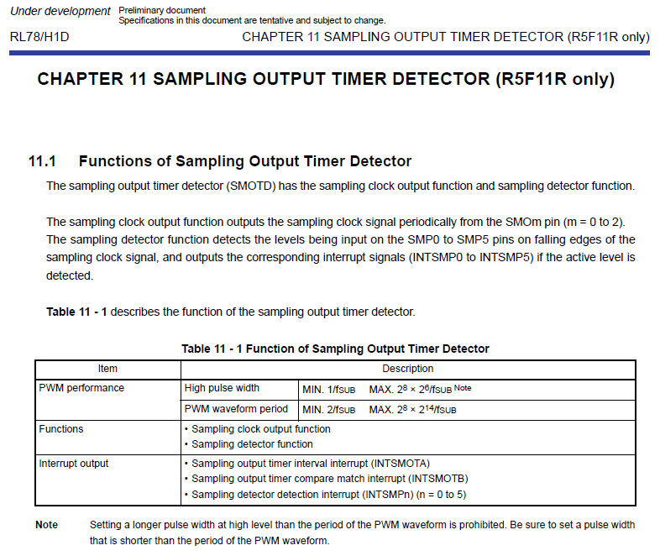
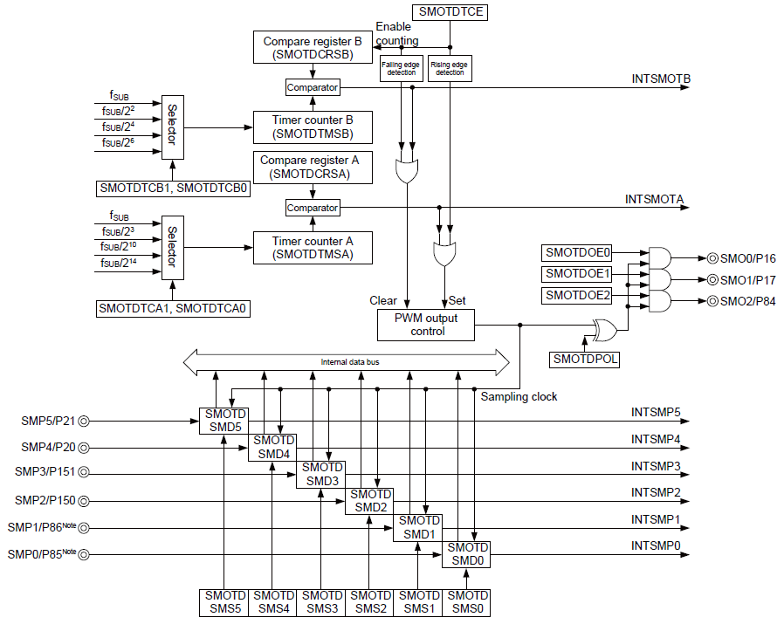
WORKS-Content
Manual learning
Detailed design
Coding
Test
User’s Manual
Block diagram of peripherals
Notes:
左边的这个流程图是一个CG项目开发的完整过程。第一阶段是手册学习，从手册中获取芯片的相关信息
或者：这是CG项目开发的流程图。第一阶段是手册学习，目的是从手册中获取芯片的相关信息
This is works-content.
The flow chart on the left of the PPT shows the whole process of a CG project.
There are four stages of this project.
The first stage is manual learning, which aims to get information about the chip from the manual.

Slide 9
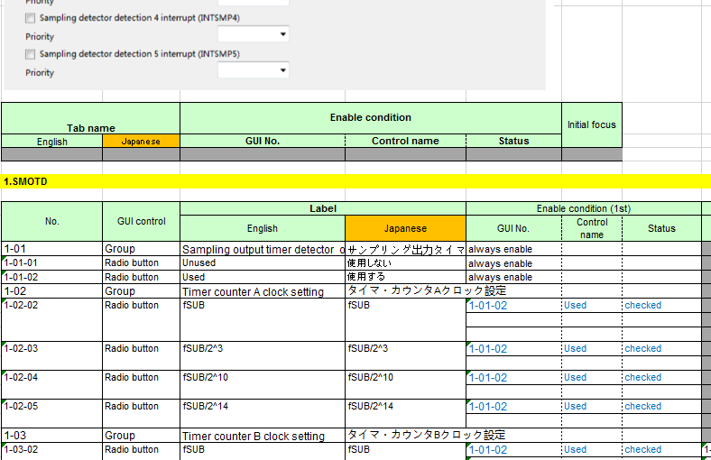
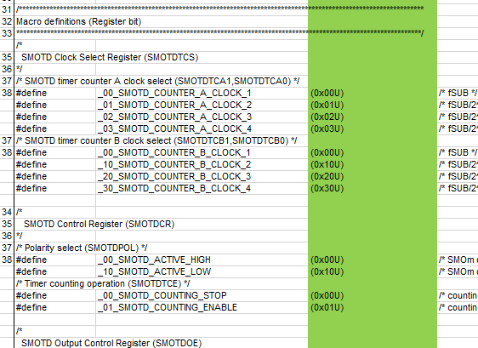
WORKS-Achievements
Manual learning
Detailed design
Coding
Test
GUI detailed design
Project | Task
RL78H1D | 8BITIT
 | SMOTD
 | WDT
 | PGA_DSAD
RL78G1J | WDT
 | CMP
 | AD
 | DA
Code detailed design
Independent design
Notes:
第二阶段是详细设计，包括界面（GUI）设计和驱动代码设计。其中SMOTD模块是我独立设计的。
或者：第二阶段是详细设计阶段，主要包括界面（GUI）设计和驱动代码设计。其中SMOTD模块的设计是由我独立完成的
The second stage is detailed design, including the GUI design and the driver code design.
I design the SMOTD module independently.

Slide 10
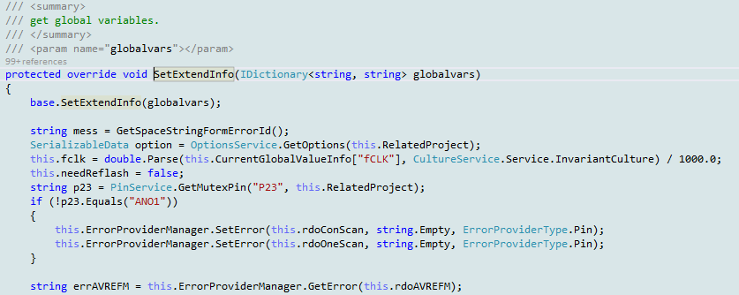
WORKS-Achievements
Manual learning
Detailed design
Coding
Test
☆ :Normal
☆☆:Hard
Project | Task | Achievement（The amount of code） |  |  |  | Difficulty
 |  | New (L) | Modify (L) | Reuse (L) | Total (L)
RL78H1D | 8BITIT | 105 | 228 | 1704 | 2037 | ☆☆
 | SMOTD | 2702 | 0 | 0 | 2702 | ☆☆
 | WDT | 0 | 89 | 800 | 889 | ☆
 | PGA_DSAD | 1224 | 1794 | 597 | 3615 | ☆☆
RL78G1J | AD | 500 | 1300 | 4900 | 6700 | ☆☆
 | DA | 200 | 500 | 1100 | 1800 | ☆☆
 | CMP | 800 | 1000 | 1600 | 3400 | ☆☆
 | WDT | 10 | 30 | 890 | 930 | ☆
Independent coding
Notes:
第三阶段是CG的编码阶段，也是CG开发中最重要的阶段。其中SMOTD模块的编码是由我独立完成的
或者：第三阶段是最重要的编码阶段。其中SMOTD模块的代码编写是由我独立完成的
The third stage is coding, which is the most important stage in CG development, and I write the code independently in SMOTD module.

Slide 11
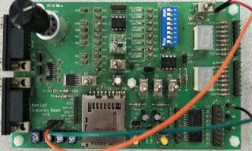
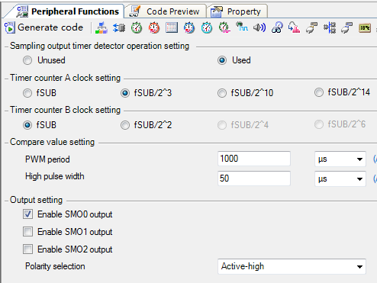
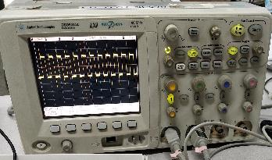
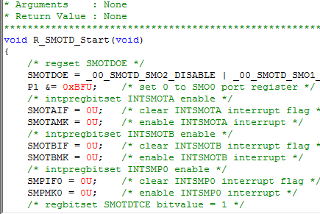
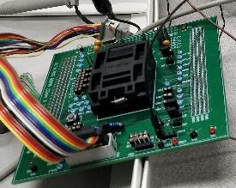
WORKS-Achievements
Manual learning
Detailed design
Coding
Test
SMOTD module
③
Input signal
①
Generate driver code
②
Download to chip
④
Output signal
Notes:
第四阶段是测试阶段，包括单元测试和硬件测试。测试的目的是为了验证CG的功能是否正确和是否满足客户需要
或者：最后是测试阶段，包括单元测试和硬件测试，目的是为了验证CG的功能是否正确和是否满足客户要求
The fourth stage is testing. The purpose of testing is test the function of CG.
By testing, We can know whether the software is working and whether it can satisfy a customer's requirements.

Slide 12
agenda
Introduction
Schedule
Work Report
Achievement
Plan And Goals
Notes:
Next,Achievement.

Slide 13

Achievement
Technique Skills
CG Development |  | Debug/Hardware test
before | After ↑↑ | before | After ↑
a little experience | can work independently | no experience | can work skillfully
Work Ability
Work efficiency
before | After ↑↑
no experience | can complete tasks on schedule with good quality
Work independently
before | After ↑↑
no experience | can work independently
Notes:
通过这次研修，我的技术知识和工作能力有了很大的提高。比如在CG开发和工作效率方面。
或者：自从入职到现在，我在技术知识和工作能力方面收获了很多。
I have gained a lot in technical knowledge and working ability since I entered the office.

Slide 14
agenda
Introduction
Schedule
Work Report
Achievement
Plan And Goals
Notes:
Finally, Plan and Goals.

Slide 15
plan and goals
Short term plans
Learn plug-in development technology based on eclipse for future development
Learn principle of complex peripherals
Such as : Timer Array Unit, Serial Array Unit
Long term goals
Strive to create first-class products
3 years
2 years
Can develop some sample frameworks and core code.
1 years
Can independently develop highly difficult modules.
Can independently develop medium difficuty modules.
Notes:
我的短期计划有两点。学习基于eclipse的插件开发技术为以后的开发做准备。学习复杂外设的原理。
这是我3年内的目标。一年内能够开发中等难度的模块，两年内能够开发高难度的模块，三年内能够开发一些简单的框架和核心代码。
I have two plans in the short term.
Plan A, learning the Plug-in Development(插件开发) technology based on the eclipse to be ready for the future development.
Plan B, studying the principle of complex external devices.
I have goals within 3 years.
I wish I can develop medium difficulty module within one year, and be able to develop more difficult modules within two years.
After that, Within three years, I can develop some simple frameworks and core code.
That is what I want.

Slide 16
Thank you!
Notes:
Thank you for watching and listening.
Thank you for everyone.

Slide 17
Renesas.com

Slide 18
Q&A

